Slide 1
Business Analytics Analysis of Qualitative Data.

Slide 2
Content
What is Qualitative Data?
Advantages of Qualitative Data.
Disadvantages of Qualitative Data.
Qualitative Data Collecting Methods.

Slide 3
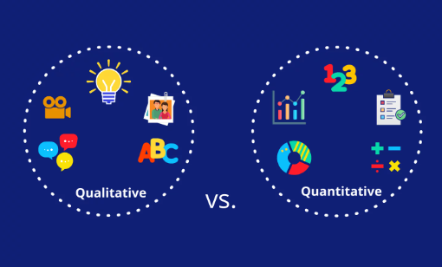
Qualitative vs Quantitative Data

Slide 4
What is Qualitative Data?
Qualitative data is defined as data that approximates and characterizes.
Non-numerical.
Qualitative data in statistics is also known as categorical data.
Qualitative data is important in determining the particular frequency of traits or characteristics.

Slide 5
Advantages of Qualitative Data
Understand the customers.
Qualitative data helps in-depth analysis.
To conduct future research.

Slide 6
Disadvantages of Qualitative Data.
Time consuming.
Harder to generalized.
Depend on the researcher’s skills.

Slide 7
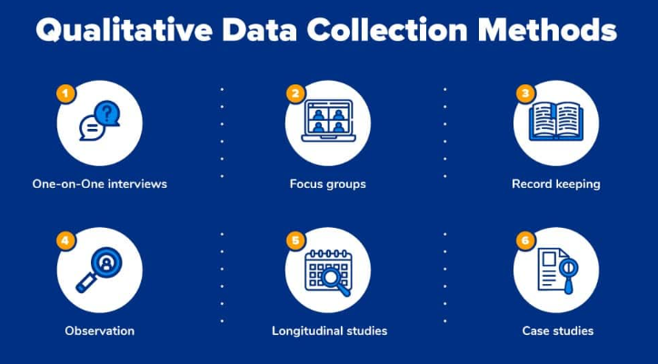

Slide 8
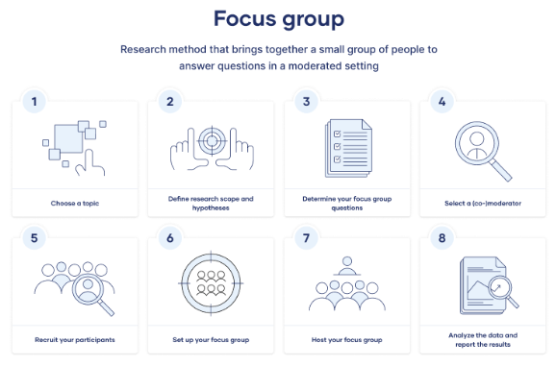
Focus Group

